Slide 1
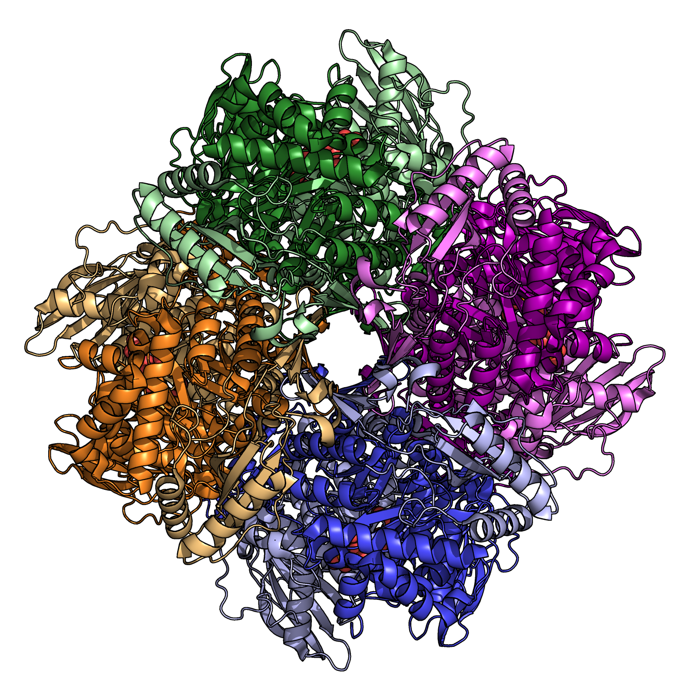
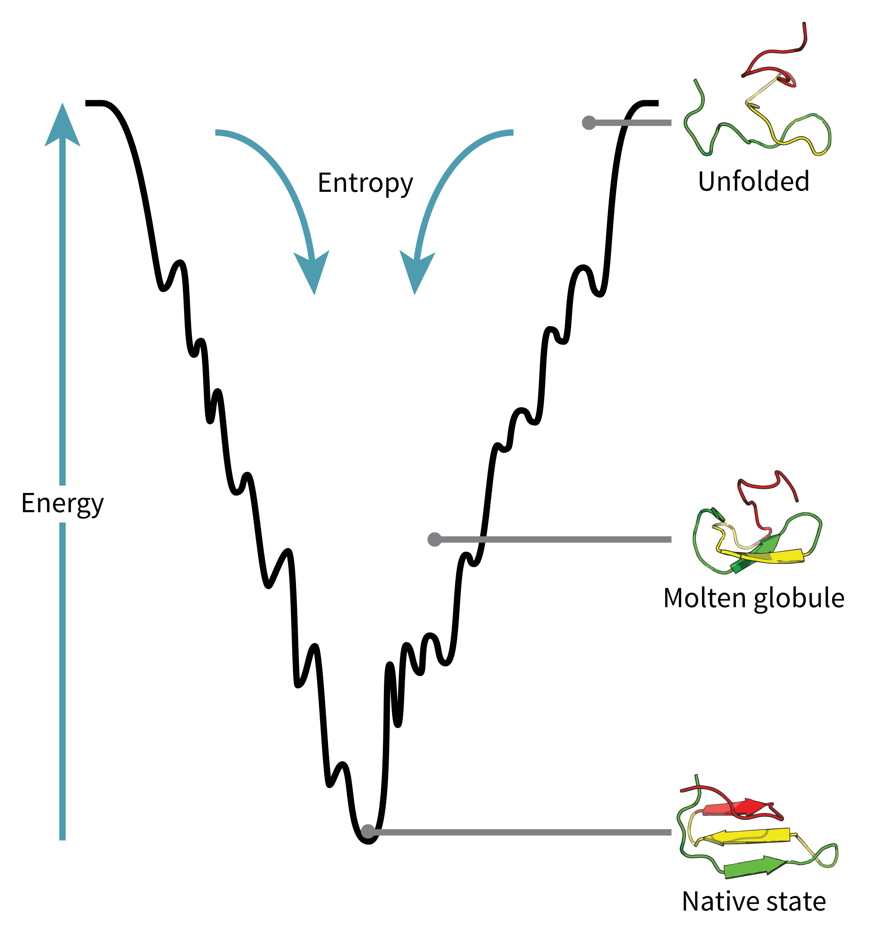
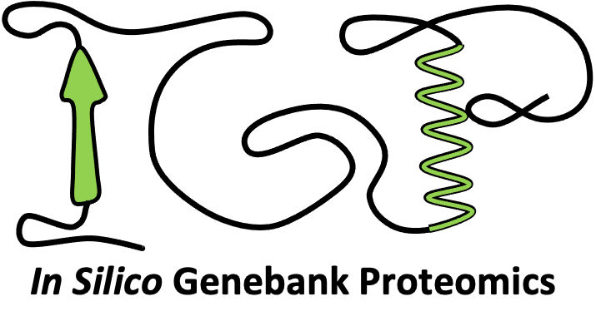

Protein
Structure &
Thermodynamics
Workshop
10th February 2025
Dr. Amanda Souza Câmara, IPK
Dr. Victor H. Rabesquine Nogueira, IPK
Prof. Dr. Antônio José da Costa Filho, University of São Paulo

Slide 2
Programme
Monday 10th 13:00 – 17:00 – Welcome to the workshop, physics in biology, introduction to protein structure with atomic models
Tuesday 11th 08:30 – 12:00 – Introduction to protein thermodynamics
Wednesday 12th 08:30 – 12:00 – Continuing protein thermodynamics
13:00 – 14:00 - Vavilov Seminar by Prof. Dr. Antônio José da Costa Filho
Thursday 13th 08:30 – 12:00 – In silico analyses of protein structure with PyMOL, AlphaFold3 prediction and docking
Friday 14th 08:30 – 12:00 – Molecular dynamics simulation

Slide 3
Introduction round
Who are you?
What is your background?
Why are you interested in protein structure and thermodynamics?

Slide 4
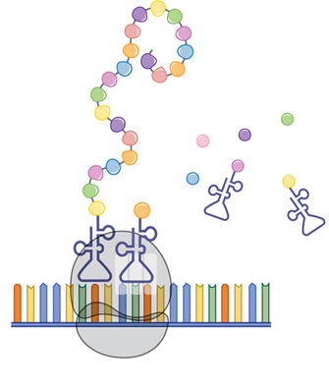
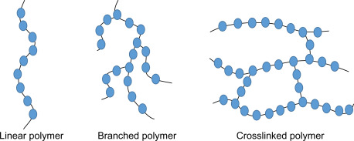
A protein is a linear polymer

Slide 5
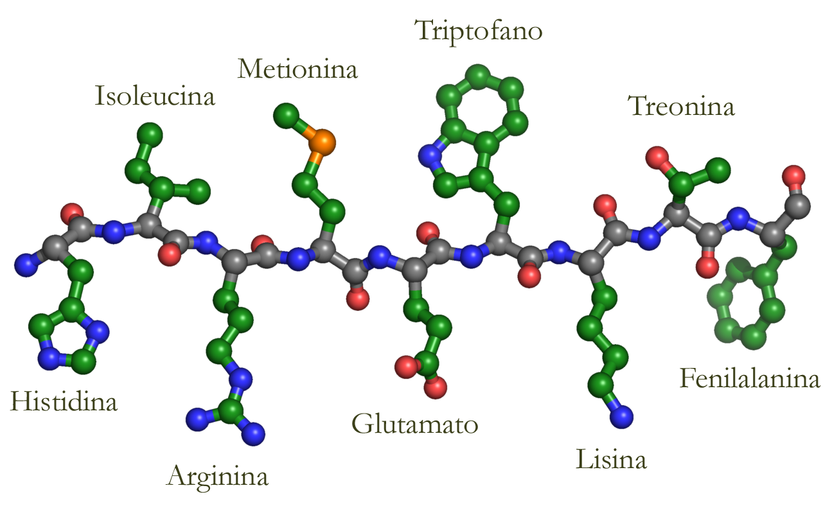
A protein is a linear polymer
Triptophan
Methionine
Isoleucine
Threonine
Phenylalanine
Histidine
Glutami Acid
Lysine
Arginine
Figure by Richard Garratt

Slide 6
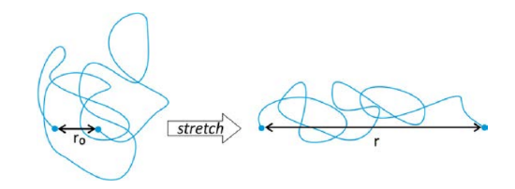
Conformations of a linear polymer
The completely stretched conformation is just one among countless possibilities.
But these conformations have restrictions!

Slide 7
Our GitHub page
https://github.com/InsilicoGenebankProteomics/Protein-Structure-and-Thermodynamics-Workshop-2025

Slide 8
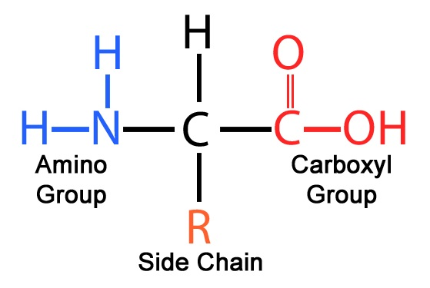
Building an amino acid

Slide 9
Building an α amino acid
α
α
β
α amino acid
β amino acid

Slide 10
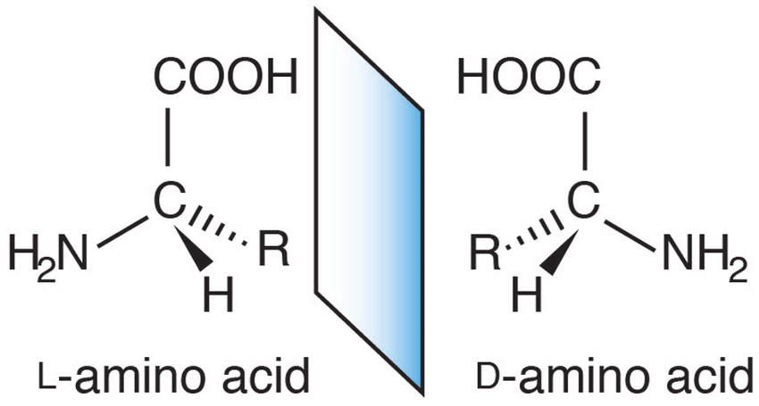
α carbons are chiral centers
α
α

Slide 11
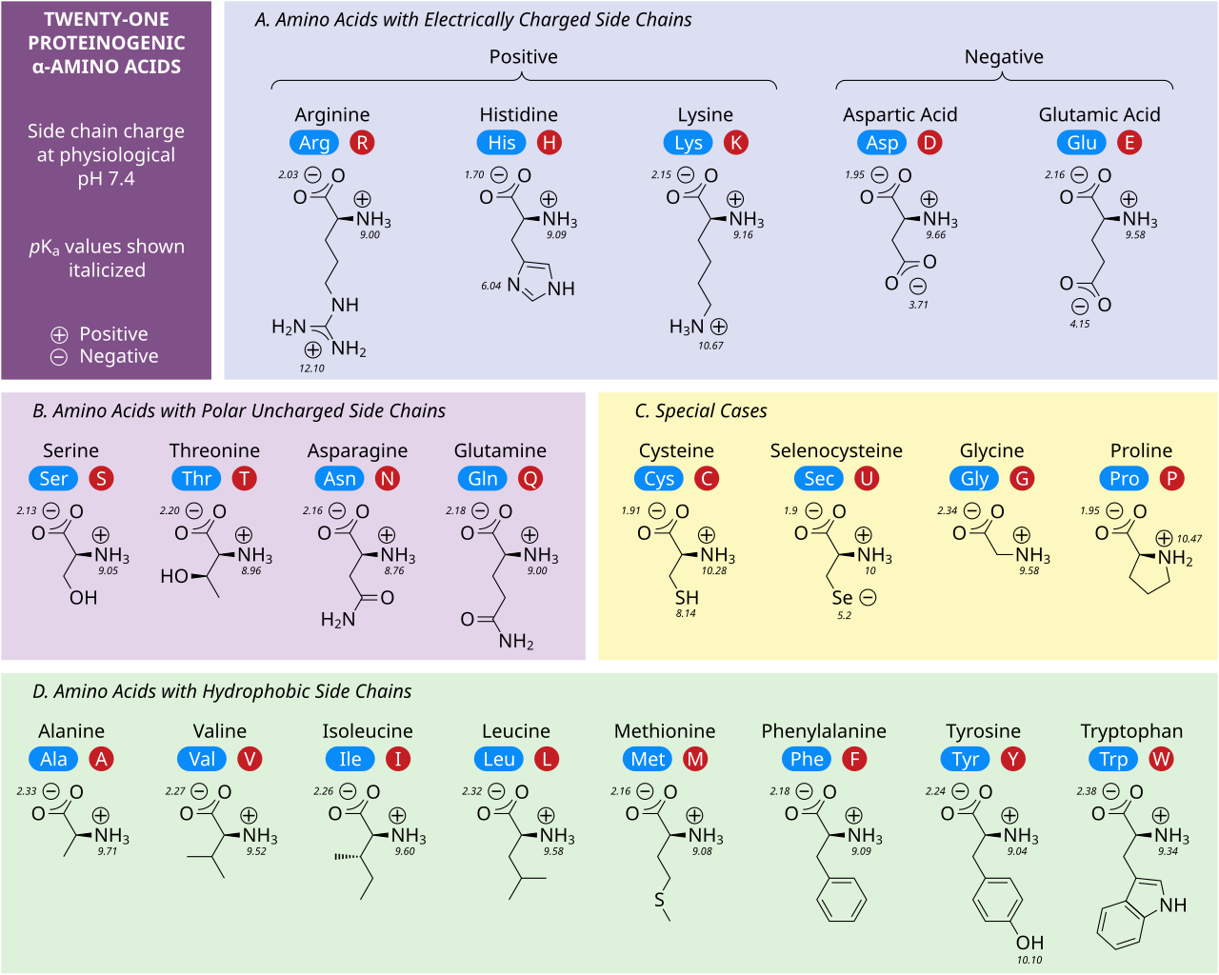
*
*Selenocysteine needs translational recoding.

Slide 12
The peptide bond
+

Slide 13
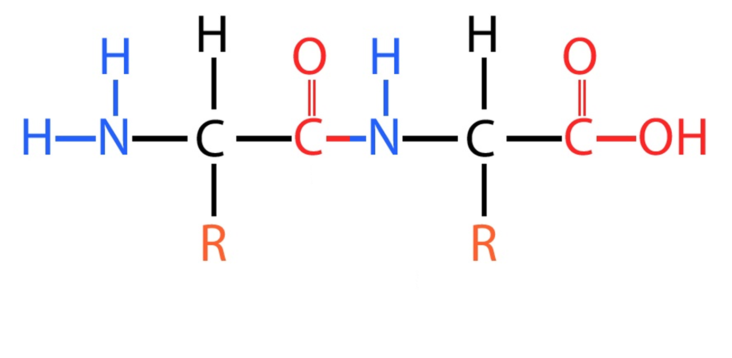
The peptide bond
From the amino-terminal end to the carboxyl-terminal end

Slide 14
The peptide bond has two resonance structures
-
+
40%

Slide 15
The peptide bond makes a plane
-
+

Slide 16
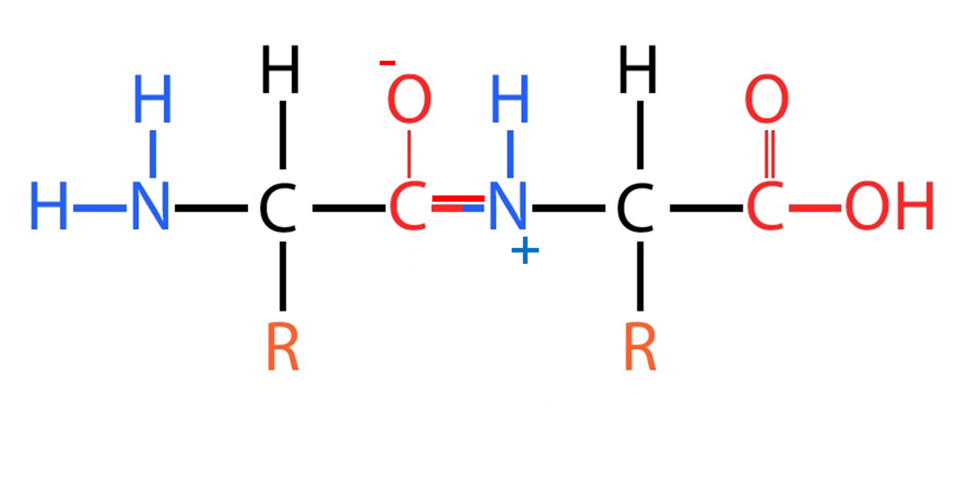
The peptide bond, cis or trans conformations
trans
cis

Slide 17
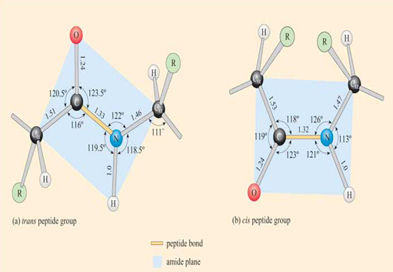
The peptide bond, cis or trans conformations
Trans Cis

Slide 18
The peptide bond, cis or trans conformations
3,84 Å
Trans Cis

Slide 19
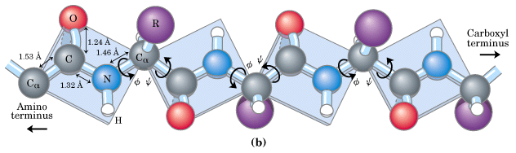
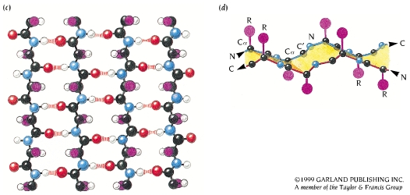
Between peptide planes are two torsion angles
Only the φ and ψ angles are free to rotate
And the positions of the main-chain atoms can be entirely defined by them.

Slide 20
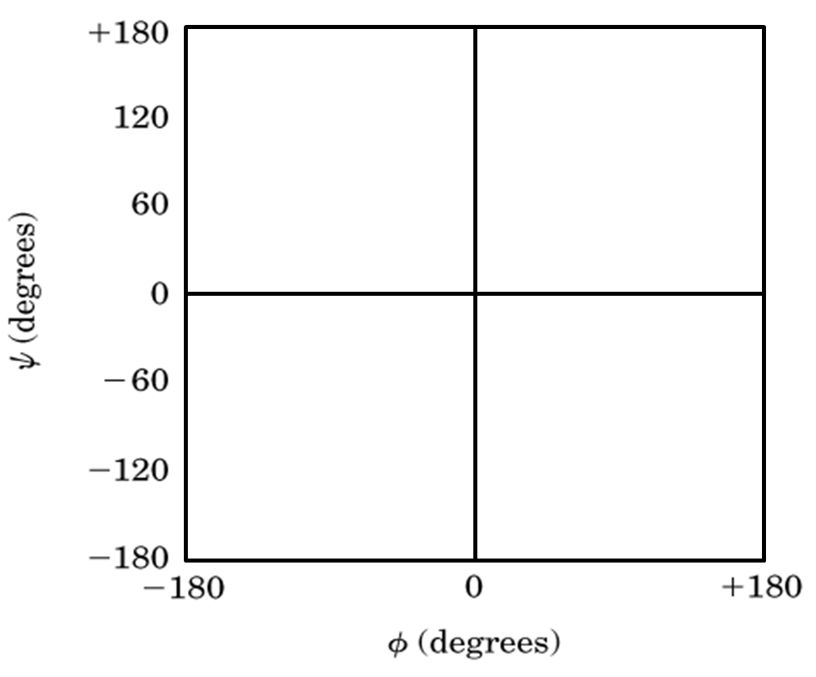
The Ramachandran plot

Slide 21
Extended conformations have low probability and high energy
Globular conformations have a hydriphobic core
Lacking water, polar groups of the main chain make hydrogen bonds with each other, forming Secondary Structures (helices and sheets)
Secondary Structures arrange into motives and domains, which arrange into Tertiary Structures
Other protein chains arrange to form Quaternary Structures

Slide 22
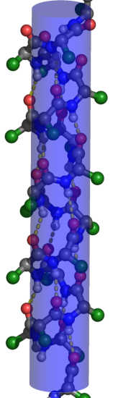
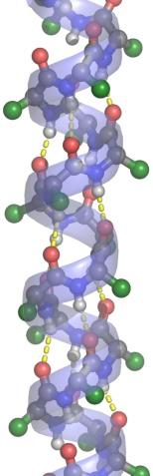
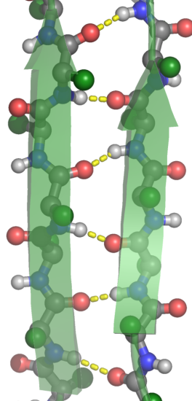
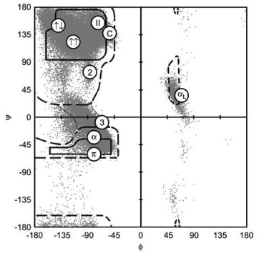
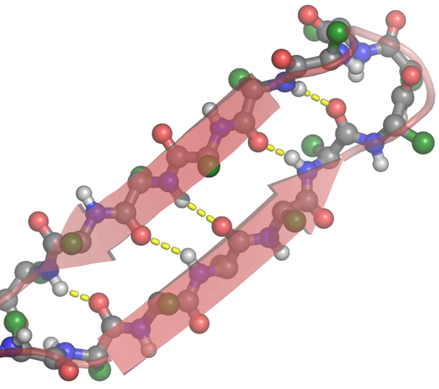
Secondary structure
Ramachandran plot
α-helices
β-sheets
Figure by Richard Garratt

Slide 23
α-helices

Slide 24
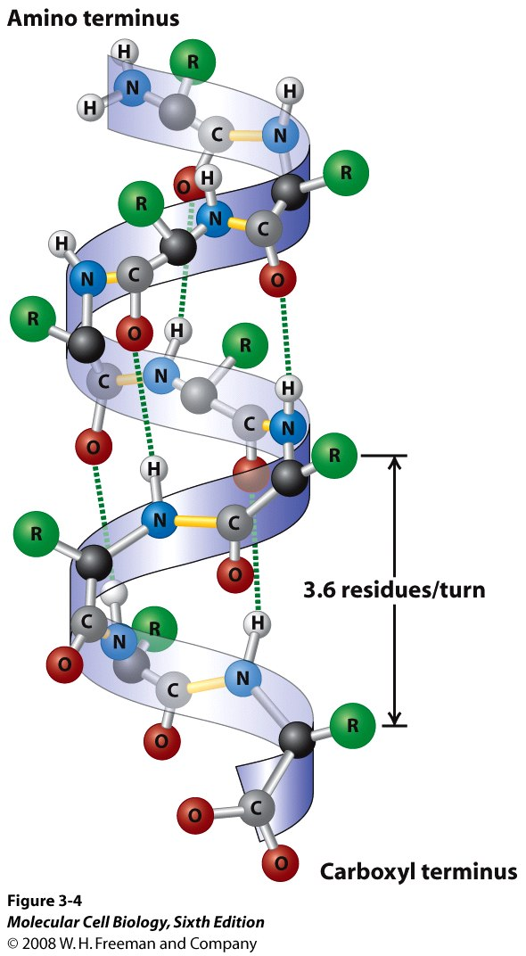
α-helices

Slide 25
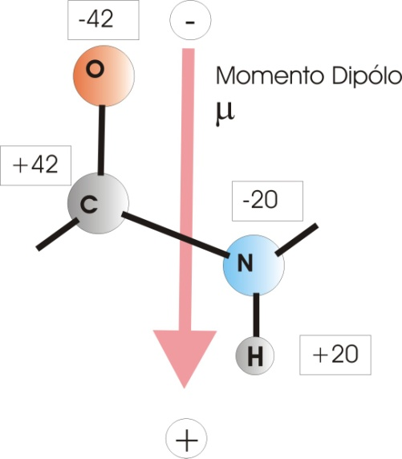
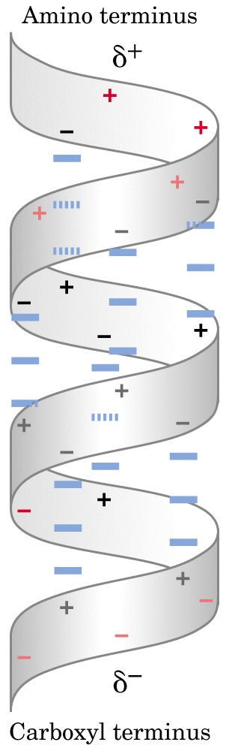
Electrical dipole
Dipole moment
Biological Function
Help in binding charged cofactors
Long range attraction (K⁺ and Cl⁻ channels)
Change the nucleophilic properties of neighbouring residues for catalysis
Slide by Richard Garratt

Slide 26
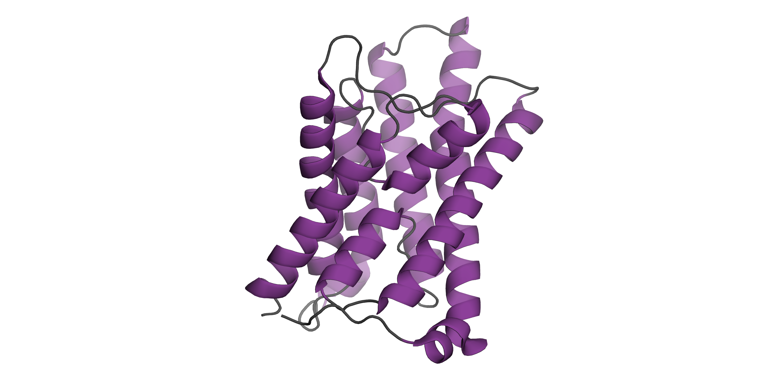
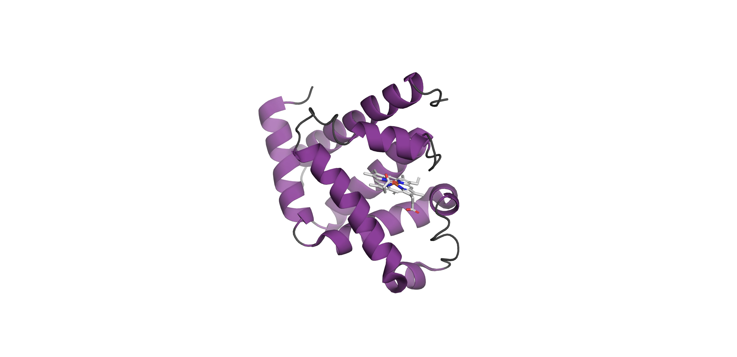
All alpha protein example
Myoglobin, 1976
Aquaporin

Slide 27
𝛃-strands

Slide 28
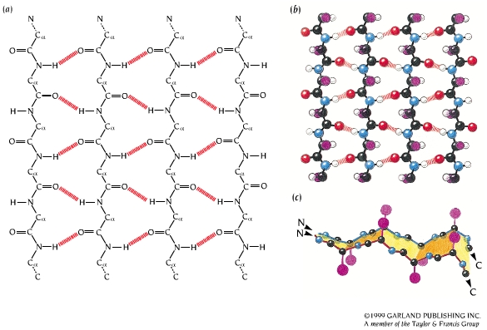
𝛃-sheets
Anti-parallel β-sheet
Parallel β-sheet

Slide 29
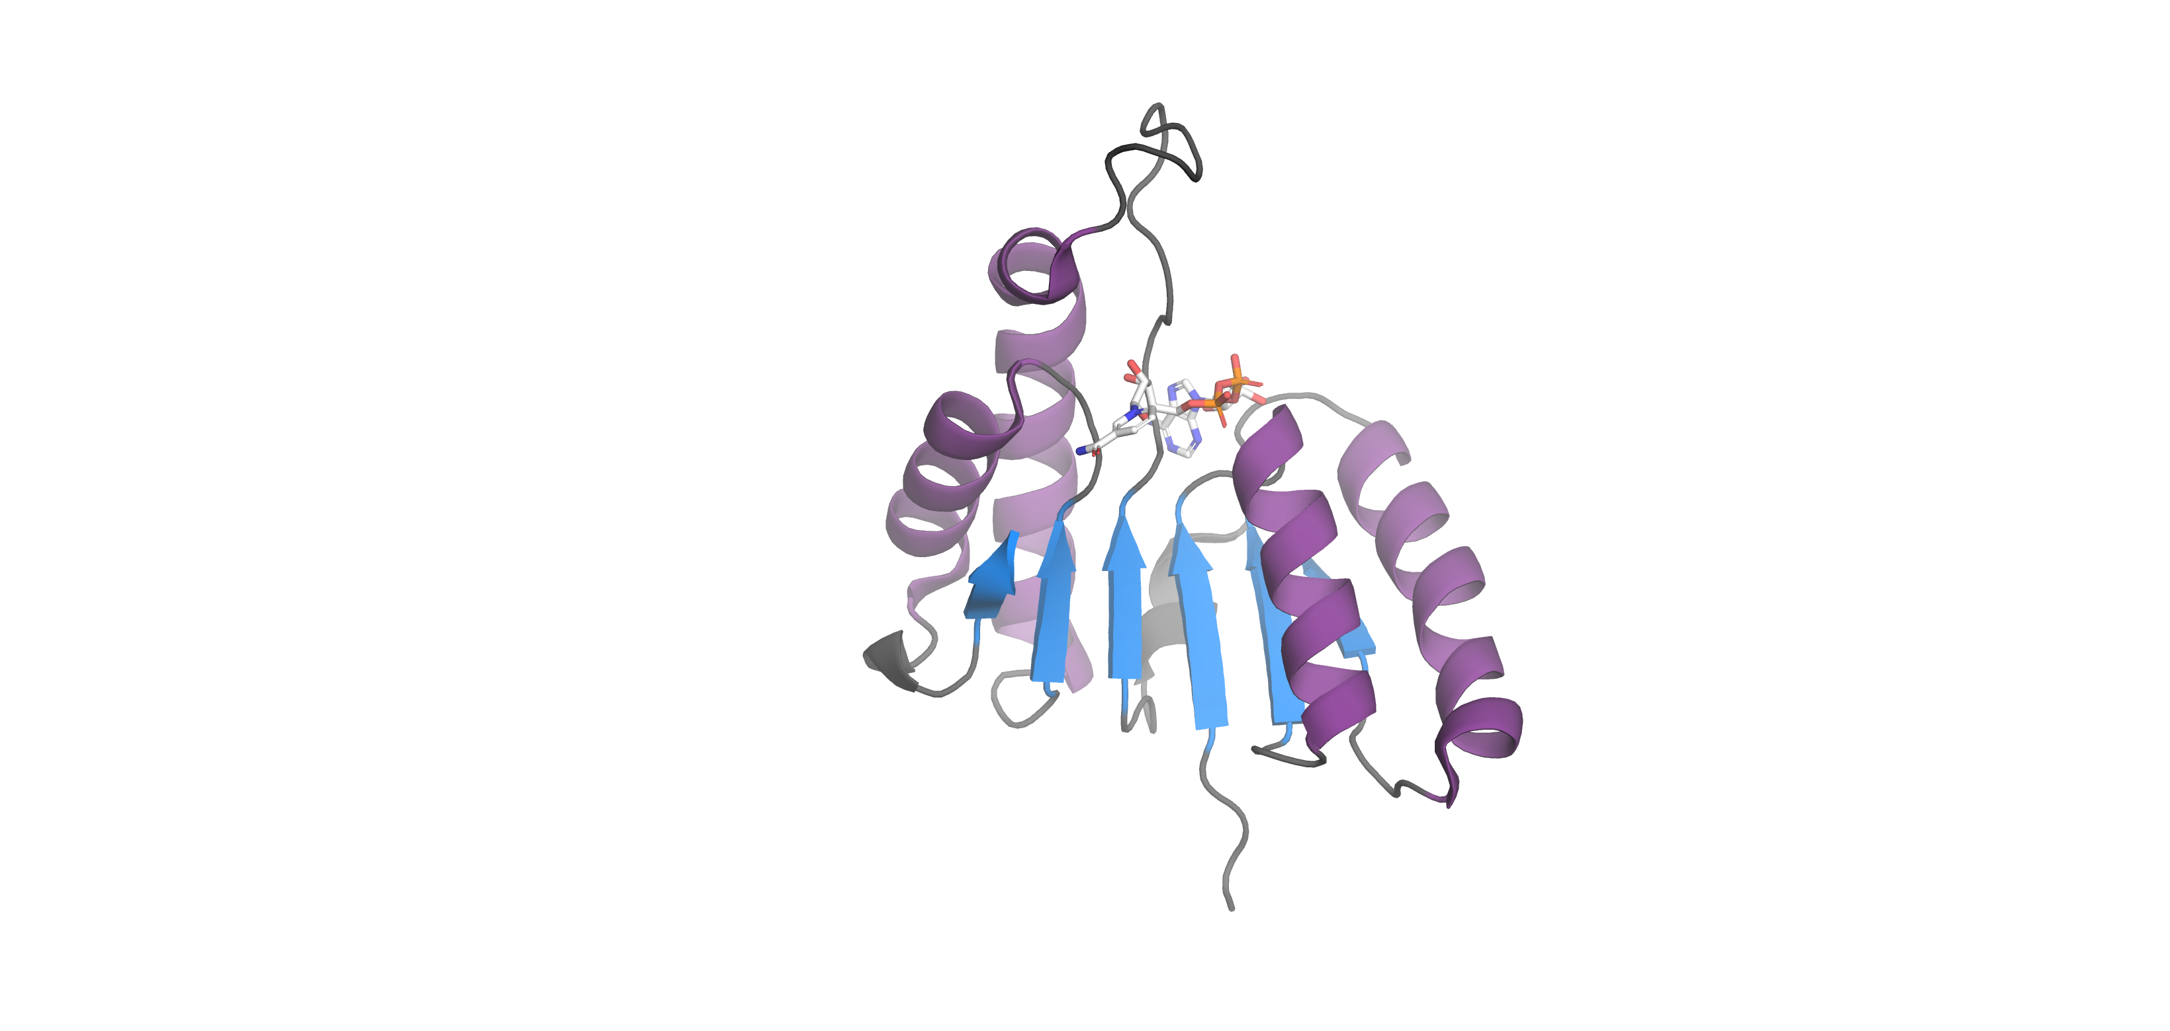
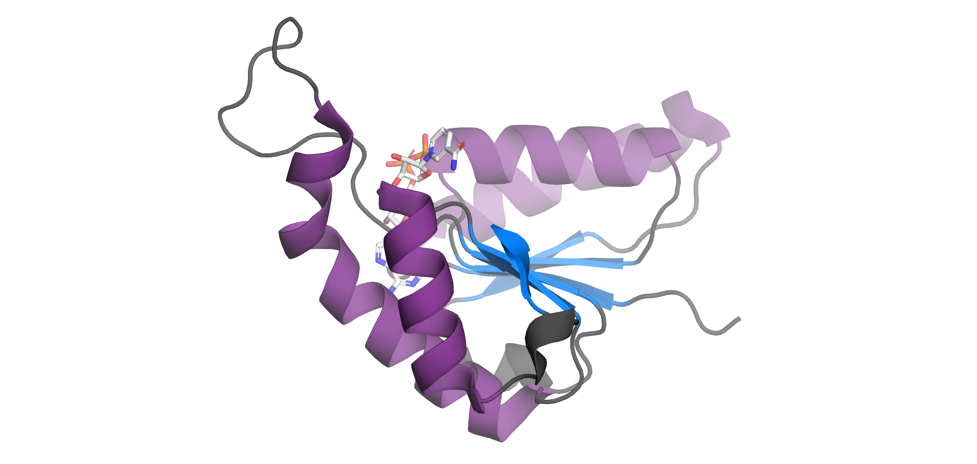
Example of beta sheet with twisted beta strands

Slide 30
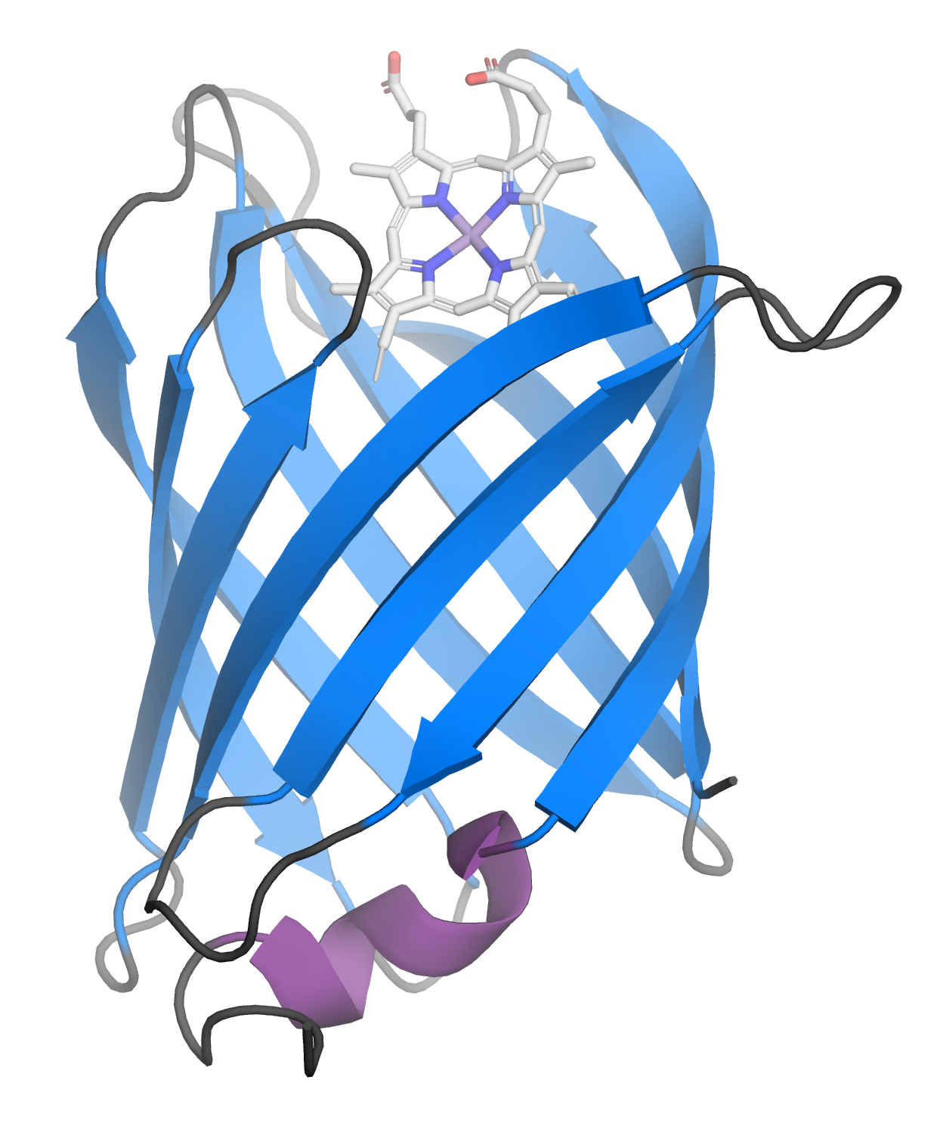
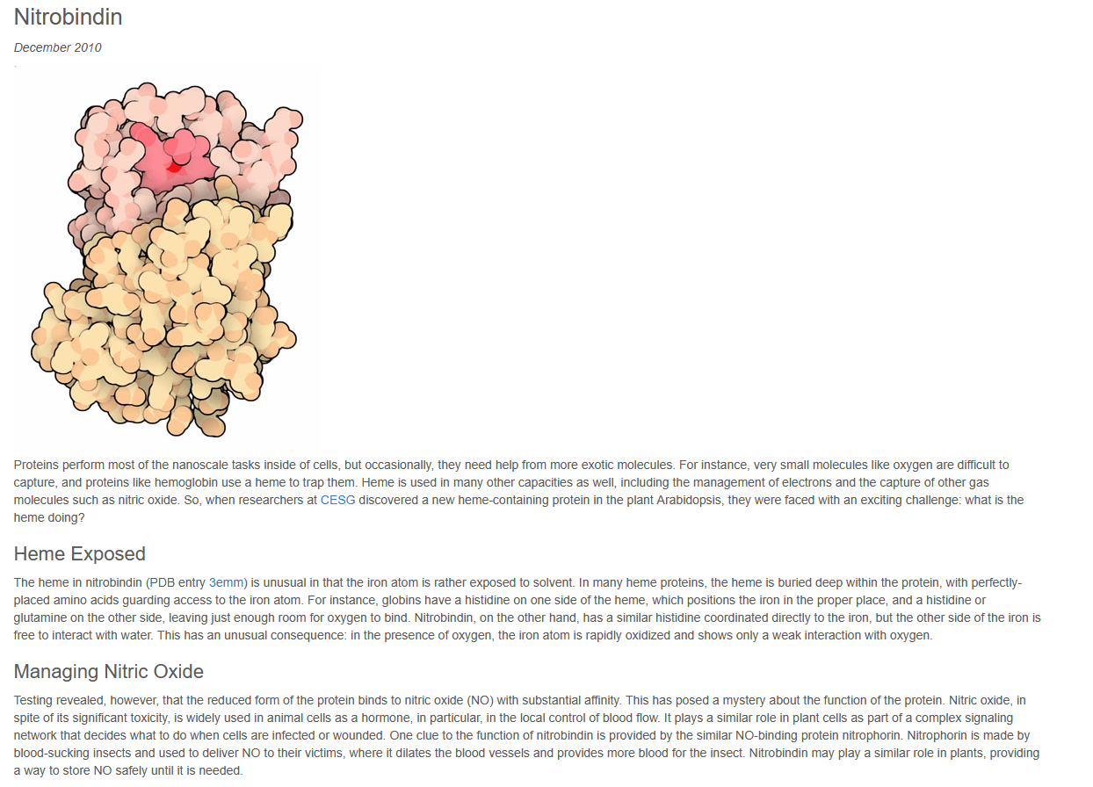
Example of a beta sheet with twisted beat strands

Slide 31
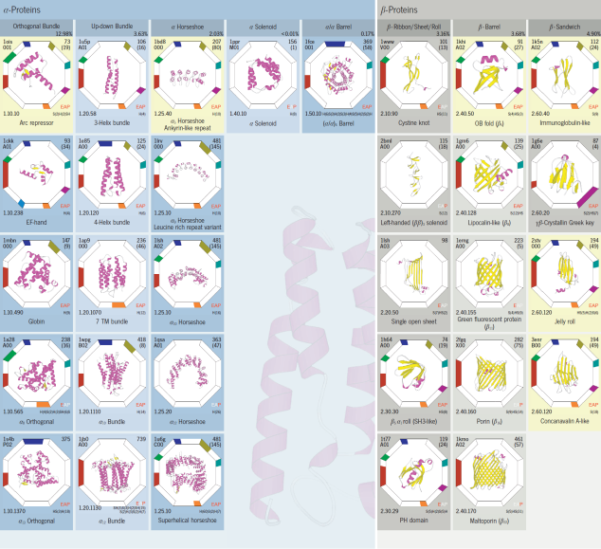
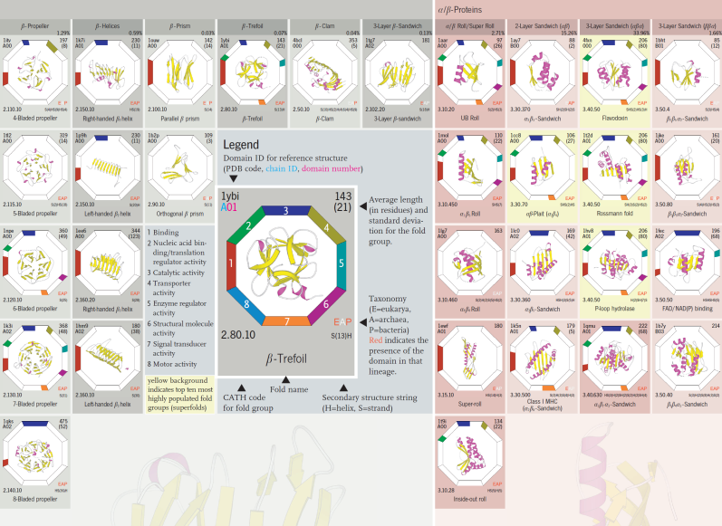
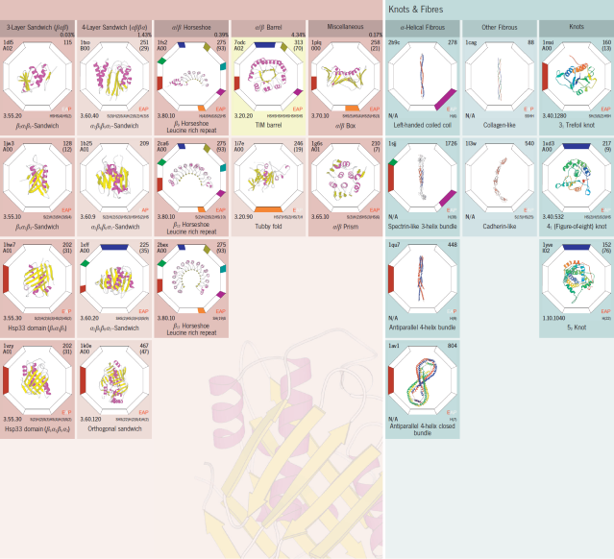
A summary of everything

Slide 32
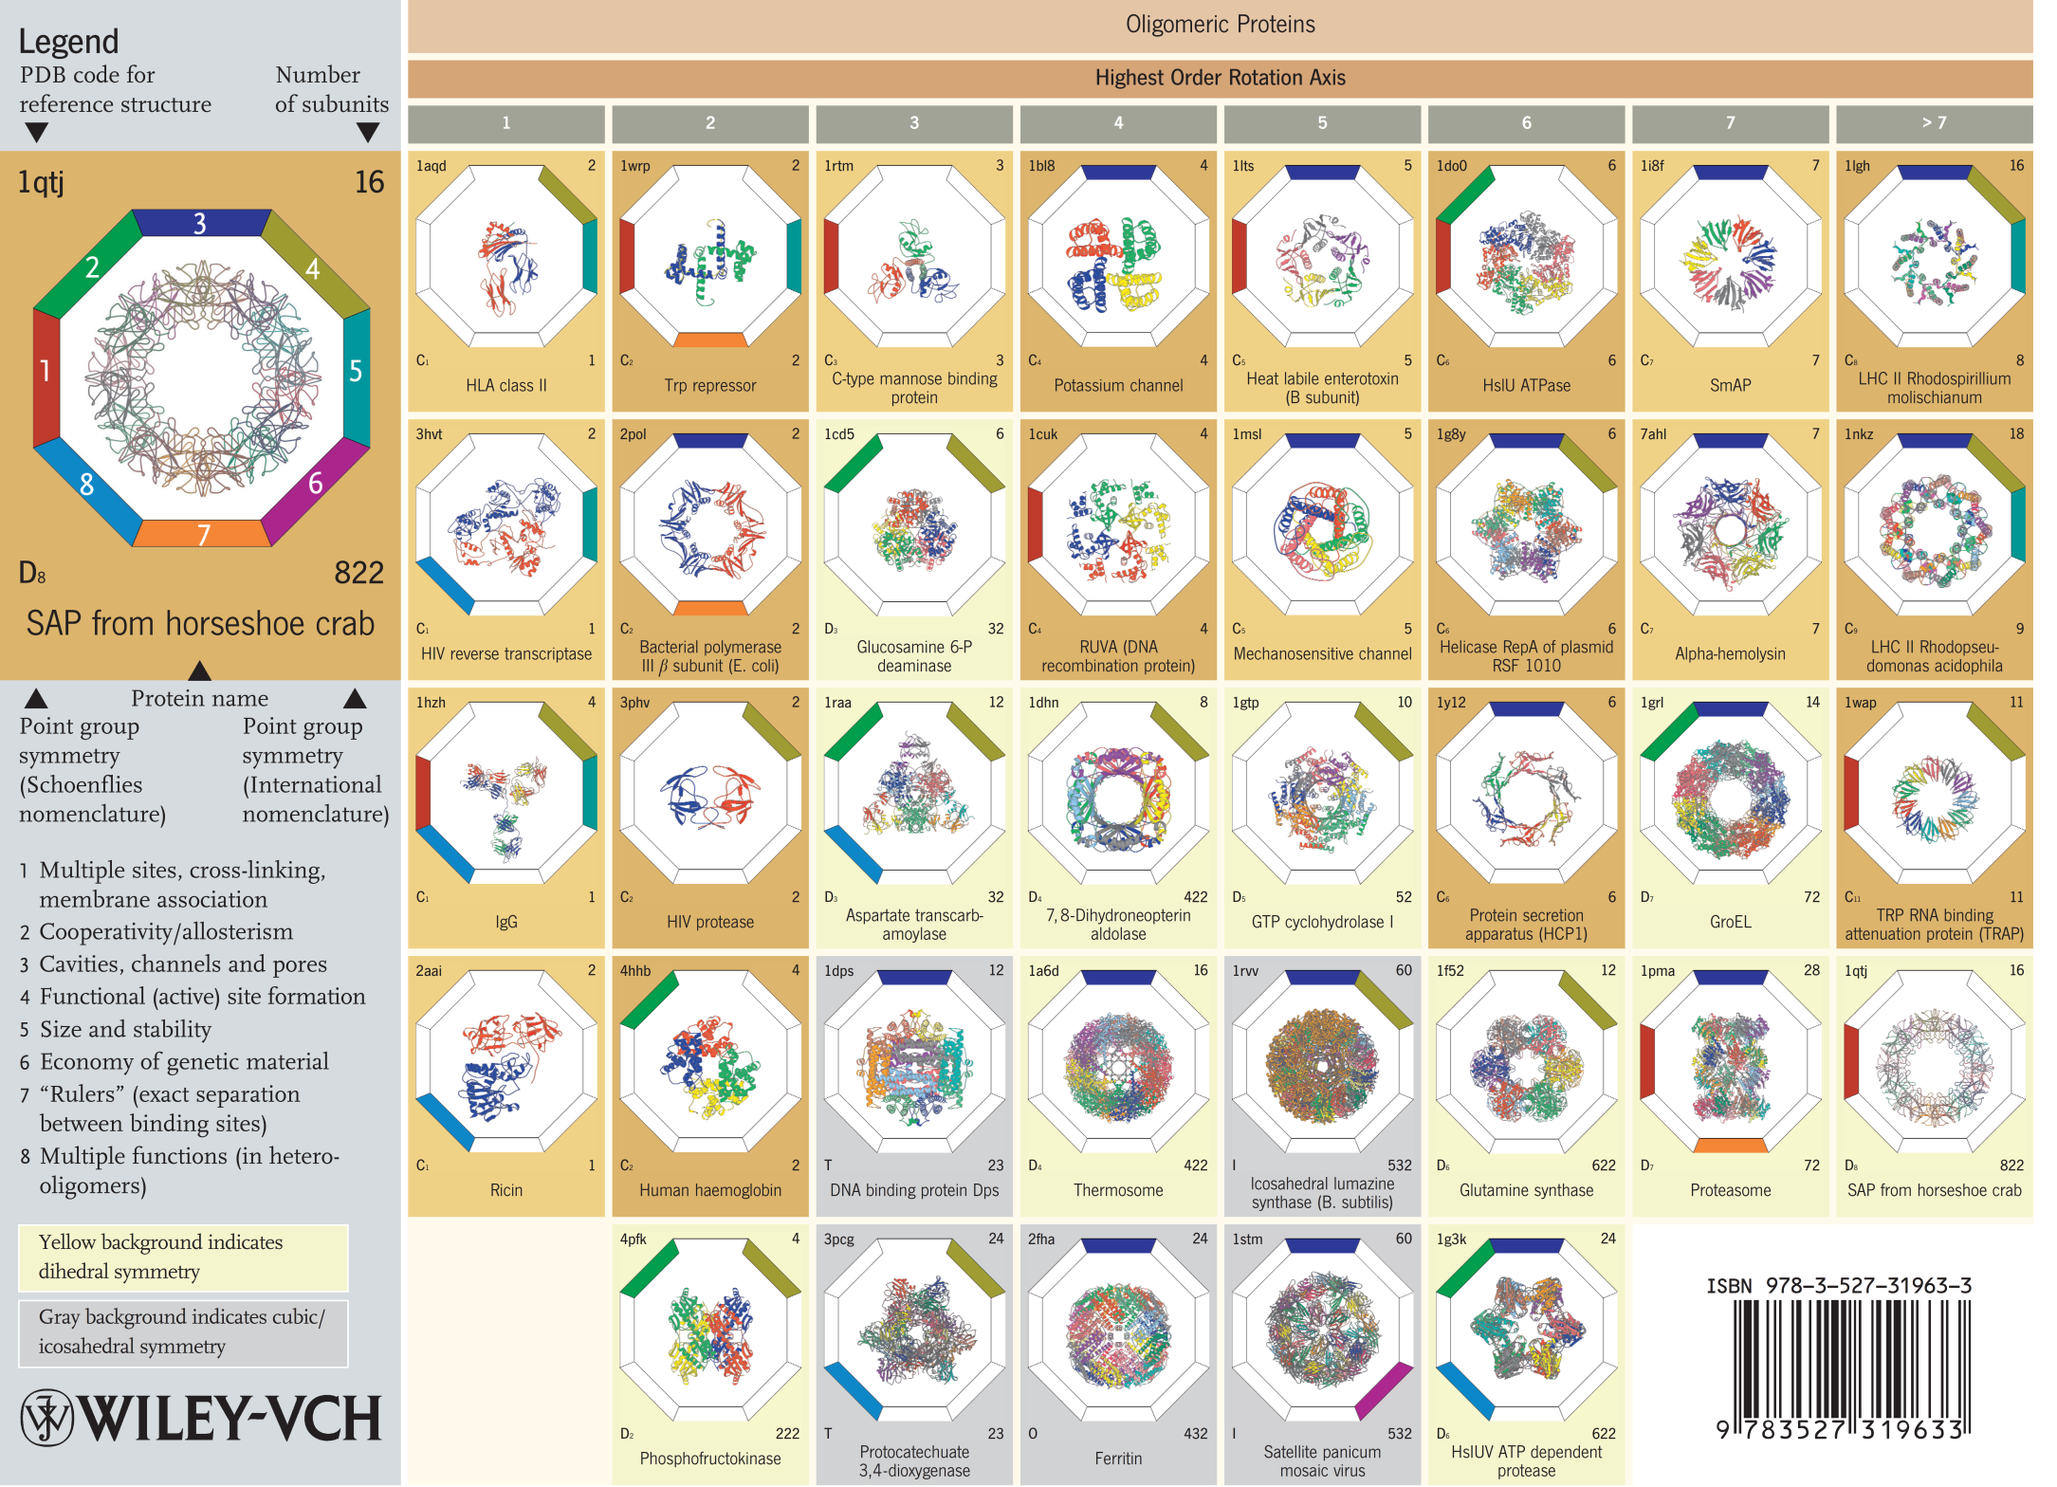

Slide 33
Why be oligomeric?
Multiple sites, cross-links, membrane association
Cooperativity/Alosterism
Cavities, channels and pores
Formation of functional sites (ative sites)
Size and Stability
Economy of genetic material
“Rulers” - exact eperation between active sites
Multiple functions (in the case of hetero-oligomers)
3
2
4
1
5
8
6
7
Slide by Richard Garratt

Slide 34
Oligomers distribution in E. coli
# subunits % proteins
1 19.4
2 38.2
3 5.4
4 21.0
5 0.1
6 5.6
7 0.1
8 2.4
9 0.0
10 0.0
11 0.0
12 1.6
>12 2.2
Polimers 2.7
Slide by Richard Garratt

Slide 35
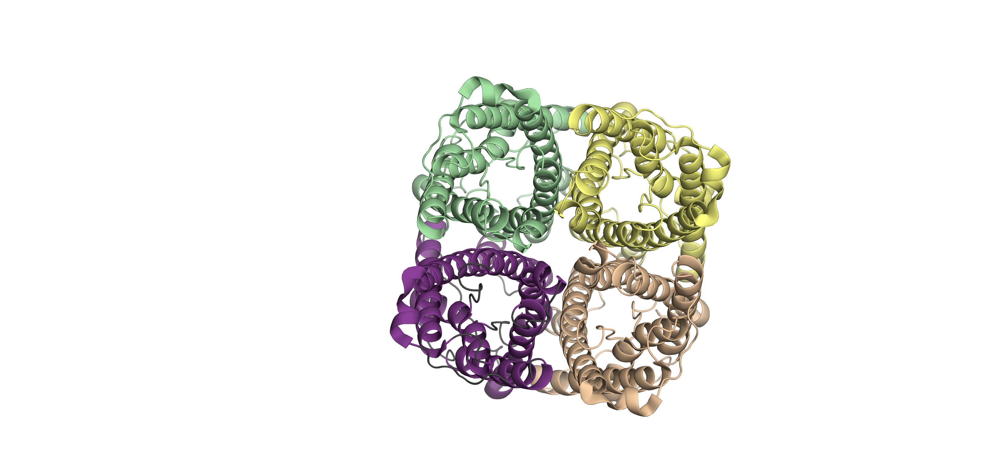
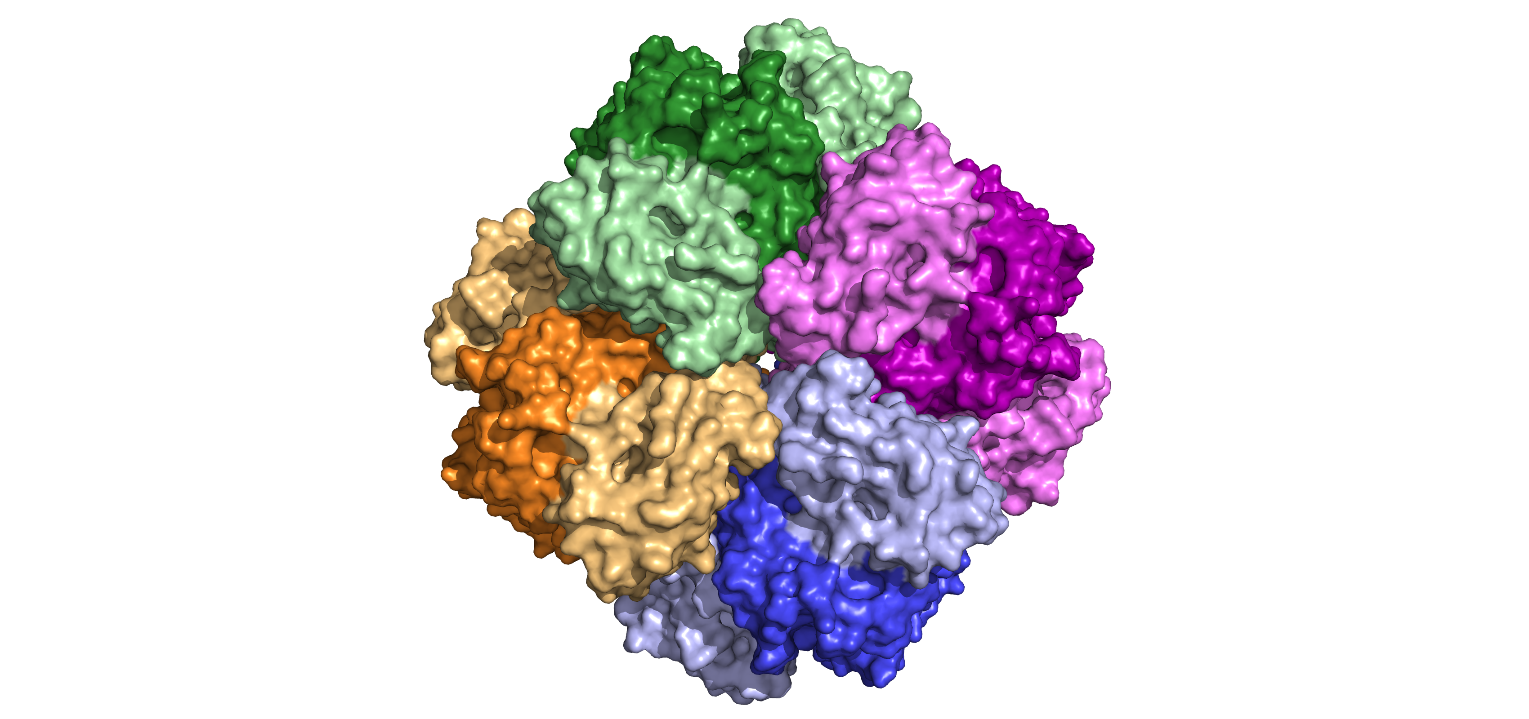
Oligomers
Aquaporin
Rubisco

Slide 36
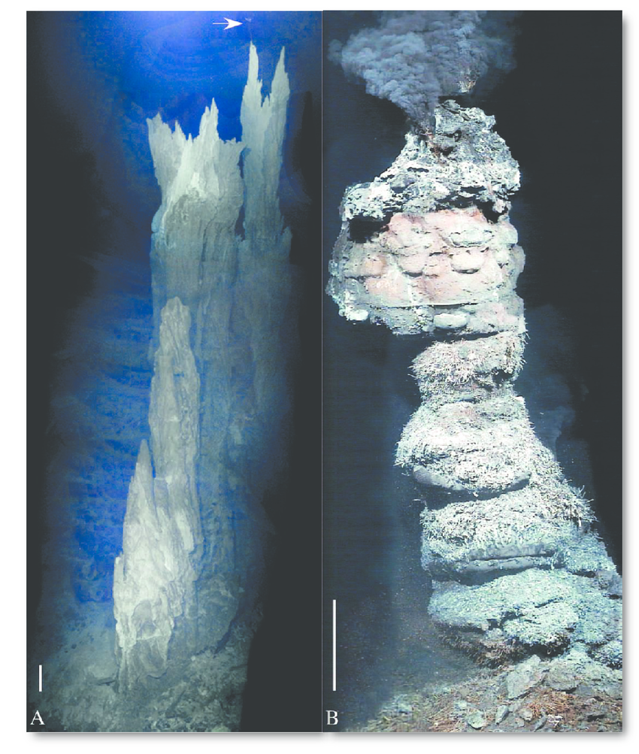
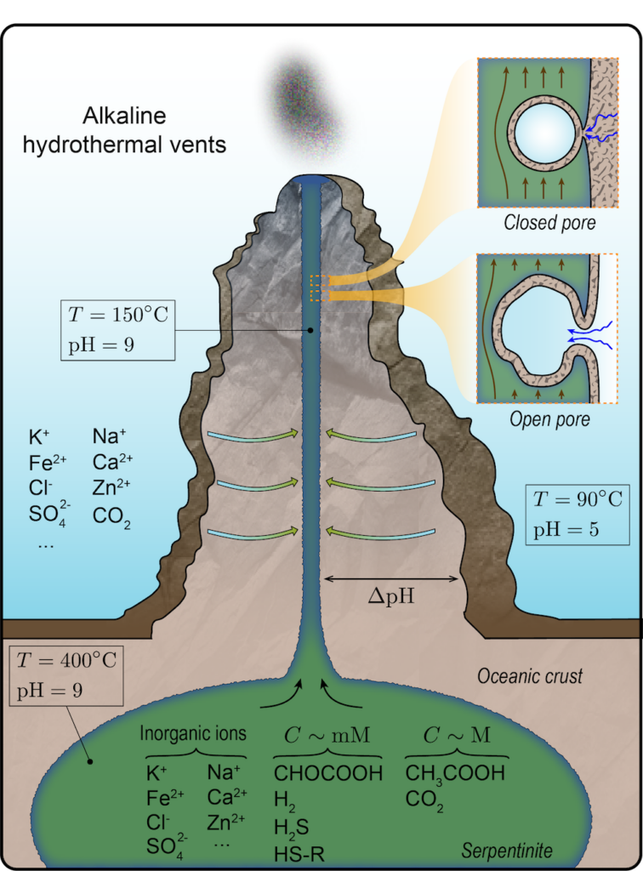
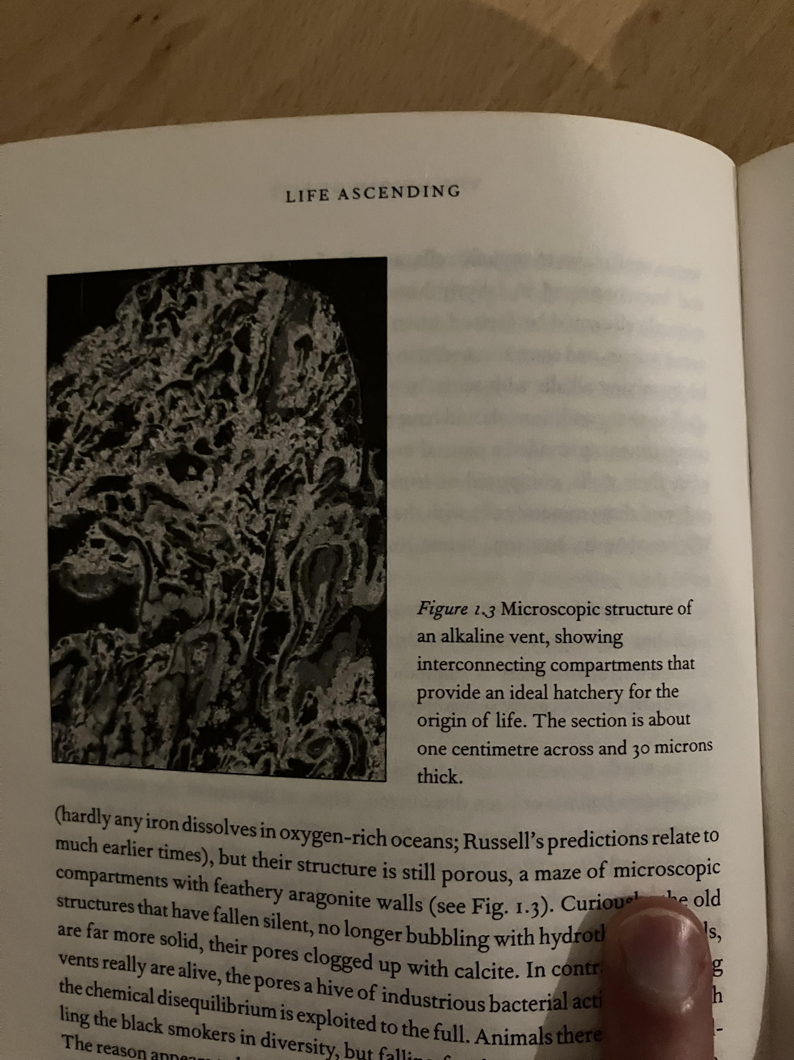
Why exactly these 20 amino acids?
Hypothetical codons of 2 base pairs: 4 x 4 = 15 possible amino acids + stop
Codons of 3 base pairs: 4 x 4 x 4 = 20 possible amino acids + stop and redundancy
1st letter – shared precursor
2nd letter – degree of solubility
3rd letter - degeneracy
Lane, 2015
Lane, Life ascending
Akbari and Palsso, 2023

